Slide 1

obj1
obj2
obj3
✔️
obj?
❌
obj1
✔️
obj?
obj2
Image
Binary mask
Distance transform
Distance transform (inverted)
Watershed idea
Segmented objects

Slide 2
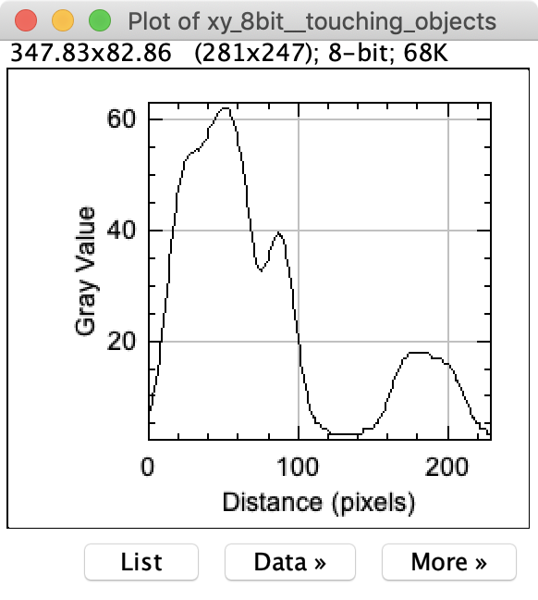
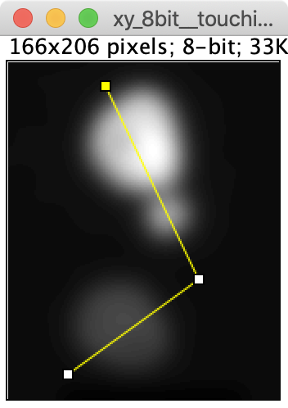
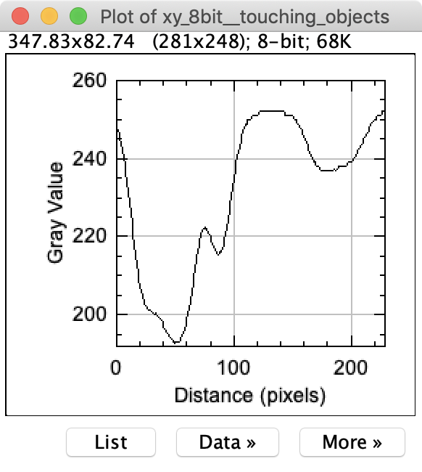
a
b
c
d
e
f
g
xy_8bit__touching_objects.tif

